Slide 1
Energy Conservation: Unit- 3
Presented
by
Dr. Pankaj Kumar,
Ph.D. (Electrical Engg.) IIT (ISM), Dhanbad

Slide 2
Refrigeration and Air Conditioning (RAC)
Refrigeration- It is a process of maintaining lower temperature compare to surrounding or It is a process of removing heat from a low temperature reservoir and transferring it to a high temperature reservoir.
Refrigeration is a process, while Refrigerator is a device.
Air Conditioning- It is a process of removing heat and moisture from the interior of an occupied space, to improve the comfort of occupants.

Slide 3
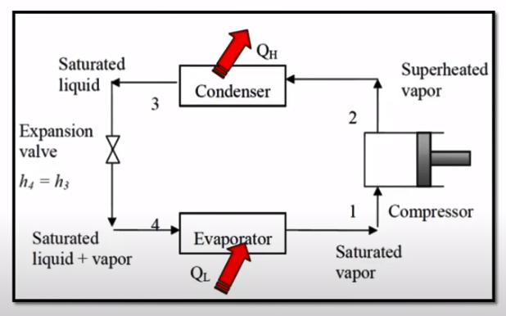
Vapour Compression Refrigeration (VCR)
It consist of mainly 4 components-
Compressor
Condensor
Expansion Valve
Evaporator
In the all four component, the Refrigerant is flowing.
Refrigerant - is a type of substance which is able to absorb the heat from the space to be cooled.
From point 4, we have refrigerant in (liquid + vapour) state. When it passess through evaporator saturated vapor is created (after absorbing the heat).
Now, at point 1, it is allowed to pass through the compressor. Compressor will increase the temperature and pressure of the refrigerant, which forms superheated vapor.
Saturated liquid - The liquid which is about to vaporise.
Example- hydrochlorofluorocarbons (used in most homes today) and Hydrofluorocarbons (used in cars), ammonia etc.
Process 2 to 3 is condensation process. Here, refrigerant will reject heat to the surrounding. The state of refrigerant at point 3 is liquid state.
This refrigerant is again allowed to flow through the expansion valve. Due to the expansion process, there is a reduction in temperature and pressure.

Slide 4
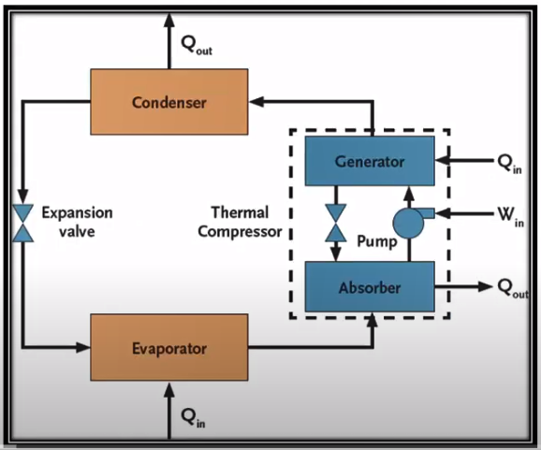
Vapour Absorption Refrigeration (VAR) System
It is a type of system, in which instead of compressor we have 4 different elements- Generator, Absorber, Pump and Non-return Path.
From the previous one, three components are common - Condenser, Expansion valve and Evaporator.
At the inlet of evaporator, refrigerant - (Saturated liquid + vapor). As it passes through the evaporator it absorbs the heat from surrounding so that it can convert from (Saturated liquid + Vapor) to Saturated vapor.
Now it is supplied to the Absorber which contains water. The vapor of refrigerand and water get mixed with each other after which converts it in pure liquid mixture of ammonia and water. The mixture of ammonia and water is pumped to the generator. In generator, heat (Q_{in}) is supplied which causes the evoporation of refrigerant (ammonia) and seperated from water. It happens due to the difference of their boiling point. The refrigerant will seperate first and leaving water.
Superheated vapor will enter into the condensor while water flows back to the absorber via valve. The water releases Q_{out} heat in absorber and again mixed with new refrigerant.
In condensor, the refrigerand condenses by leaving the heat Q _{out} and process continues..

Slide 5
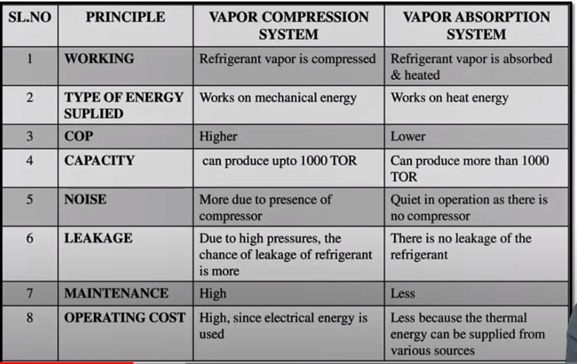
Difference Between VCR and VAR
TOR- ton of refrigeration,
COP- Coefficient of Performance is a ratio of useful heating or cooling provided to work (energy) required.

Slide 6
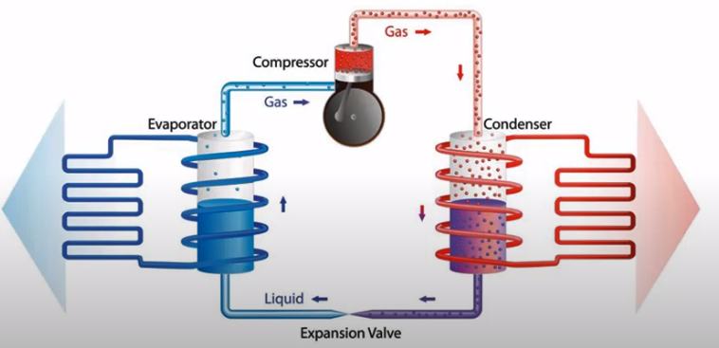
Heat Pump
From construction point of view, heat pump and refrigerator are similar, but basic difference is -
In refrigerator, we use it for cooling application while in heat pump we use it for heating application.
The rejected heat from the condenser is utilized in heat pump for heating applications.
https://www.youtube.com/watch?v=7ixIPGqCOj4

Slide 7
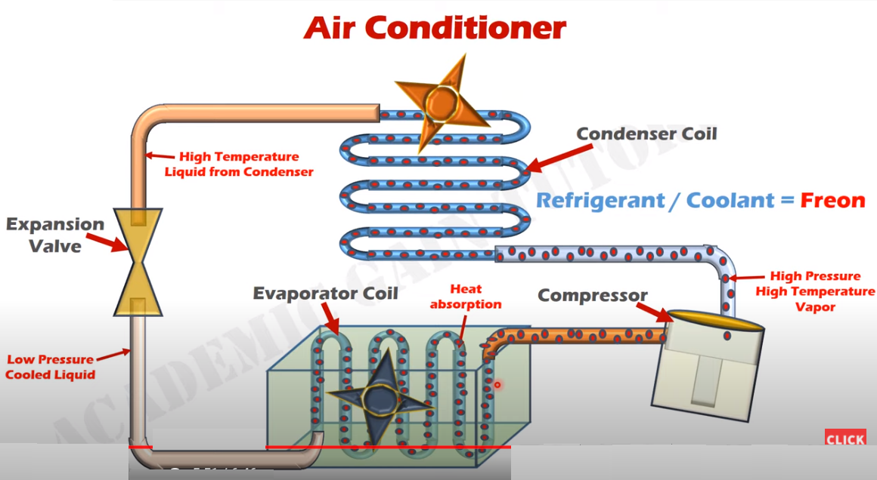
https://www.youtube.com/watch?v=GzEMdQk1QTk&ab_channel=AcademicGainTutorials

Slide 8
Factors affecting performance of Referigeration and Air Conditioning System-
Maintenance of Heat Exchanger Surface
System Design Features
Capacity and control of Energy Efficiency
Design of Process Heat Exchangers

Slide 9
DG Generator Sets (DG Sets)
Consist of the following components-
Diesel Engine and its accessories
AC Generator
Control System and Switch Gear
The foundation and power house civil works
Connected loads

Slide 10
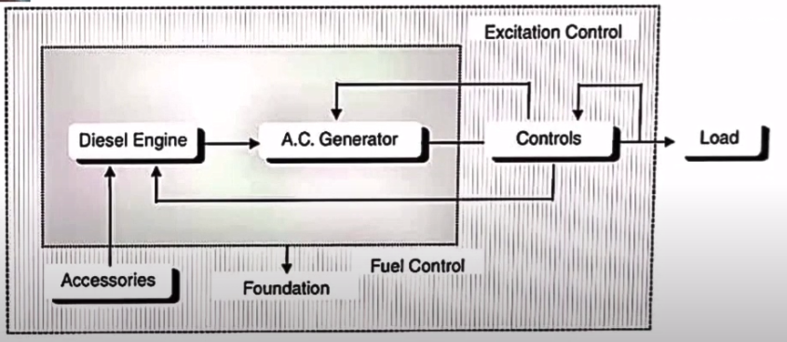
Block Diagram of DG Set

Slide 11
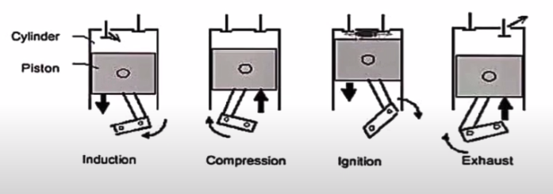
Continued...
Diesel Engine- Diesel Engine is an prime mover which drives the alternator to produce electrical energy. In diesel engine, the air is drawn into the cylinder and compressed to high ratio (14:1 to 25:1).
During the compression, the air heated the temperature of (700-900) °C.
The fuel is injected at that time and it ignited spontaneously.
Four Stroke Diesel Engine-
1. Induction Stroke - Fresh air is drawn in.
2. Compression Stroke- Air is compressed.
3. Ignition and Power Stroke- Fuel is injected.
4. Exhaust Stroke- Gases gets exhausted.

Slide 12
Diesel Genetrator Power Plants
These power plants used in emergencies and used in small power systems. The main reason of using these power plants is its high efficiency of diesel engines compared with gas and steam turbines.
Advantages-
Low installation cost
High efficiency (43%-45%)
Minimum cooling water required
Short startup time.

Slide 13
Energy Efficiency Opportunities in DG Sets
Ensure steady load conditions on DG Sets and provide and provide cold dustfree air to intake.
Improve air filteration.
Ensure fuel oil storage, handling as per recommendations of manufacturer.
Consider fuel oil additives if they benefit oil properties.
Caliberate fuel injection pump frequently.
In case base load operation condition, considerwaste heat recovery system adoption.
Consider parallel operation among DG Sets for improved loading and fuel economy.
Carry out regular field trials to monitor the DG performance and maintenance planning as per the requirement.
https://www.youtube.com/watch?v=ib1OwRAGux4&ab_channel=e-BRILLIANTMINDS

Slide 14
Energy Efficiency in Building
In current times the rapid infrastructure growth and looming energy crisis, there is a strong need to address and encorporate good practices for efficient energy and resource use while planning for building, be it for residential purpose or for commercial application.
Some such good practices are presented in the Subsequent discussions:-
Green Buildings:- Feauture of Green Buildings are-
Use of energy efficient and Eco-FriendlyEquipment.
Use of Recycled and Environment Friendly Building Materials
Quality Indoor air for human safety and comfort
Use of renewable energy
Effective Controls and Building Management System
Efficient use of water
Use of Non-Toxic and Recycled Materials
Effective use of existing landscapes
Adoption of cost-effective and environement friendly technologies.

Slide 15
Benifits of Green Buildings
(30-40)% reduction in operation cost.
Green Corporate Image.
Health and safety of the building occupant.
Enhance Occupant Comfort.
Improve productivity of occupant.
Typical Features of Green Buildings
Reduction of Building footprints to minimise the impact on environment.
Installation of high efficiency irrigation methods and selection of vegetation which have low water consumption.
Harvesting of site energy.
CFC free HVAC equipments.
Energy efficient equipments for air conditioning and lighting system.
Use of on-site renewable energy.
Measurement & verification plan to ensure energy and water saving.
Controls and building management system.

Slide 16
Continued...
Segregation (isolation) collection and disposal of waste streams at source.
Use of building materials having high recycled content.
Use of rapidly renewable materials (the materials which could be replenished within a life cycle of 10 years).

Slide 17
Saving Opportunities in HVAC, Fans and Blowers
HVAC (Heating, Ventilation, and Air Conditioning)-
1. BUILDING ORIENTATION/ ARCHITECTURAL FEATURES-
(i) Orientation
(ii) Double Glass
(iii) Insulation on roof
(iv) No Leakage ( FromWindows/ Doors/ Ceiling)
(v) Long side should be having minimum heat gain.
(vi) Plant room and Air Handling Unit (AHU) locations should be such that ducting/ piping are minimum.
(vii) Fresh air intake should be sufficient to avoid “Sick Building Syndrome”
(viii) Sun shades over the glass area with proper inclination to avoid direct sunrays.
(viii) Partitions and closure of air grills of unutilized conditioned space.

Slide 18
Continued...
2. ESTABLISHING BASELINE PERFORMANCE INDICES:
Usage time schedule – Working hours, holidays etc.
tons / Sqr. Meter
kW / ton
kWh / day
kWh / year
3. AUTOMATION AND BUILDING MANAGEMENT SYSTEM: Automation and building management systems are now increasingly used in the airconditioning systems for centralized monitoring and controlling the operations so as to ensure optimum operations of all the machines without any wastage of energy in overcooling or overheating of the areas.
4. VARIABLE VOLTAGE AND VARIABLE FREQUENCY DRIVES [VVVF] OR VARIABLE SPEED DRIVE:
In the VVVFD systems , the voltage and the frequency of electric supply to the induction motors for fans , pumps and compressors can be steplessly varied to control the speed of the motor in tune with the load requirements.
5.HEAT RECOVERY WHEEL AND DESICCANT (sustain a state of dryness) COOLING SYSTEM FOR FRESH AIR :
6. ROOF TOP CHILLERS: Roof top chillers are now increasingly used as they can be mounted on the
roof and the costly built up space inside the building can be saved.
A chiller is a machine that removes heat from a liquid coolant via a vapor-compression, adsorption refrigeration, or absorption refrigeration cycles.
7. GEOTHERMAL SYSTEMS: Solar Energy Centre, Gulpahari Gurgaon constructed by TERI has used innovative scheme of providing airconditioning by harnessing in geo-thermal energy.

Slide 19
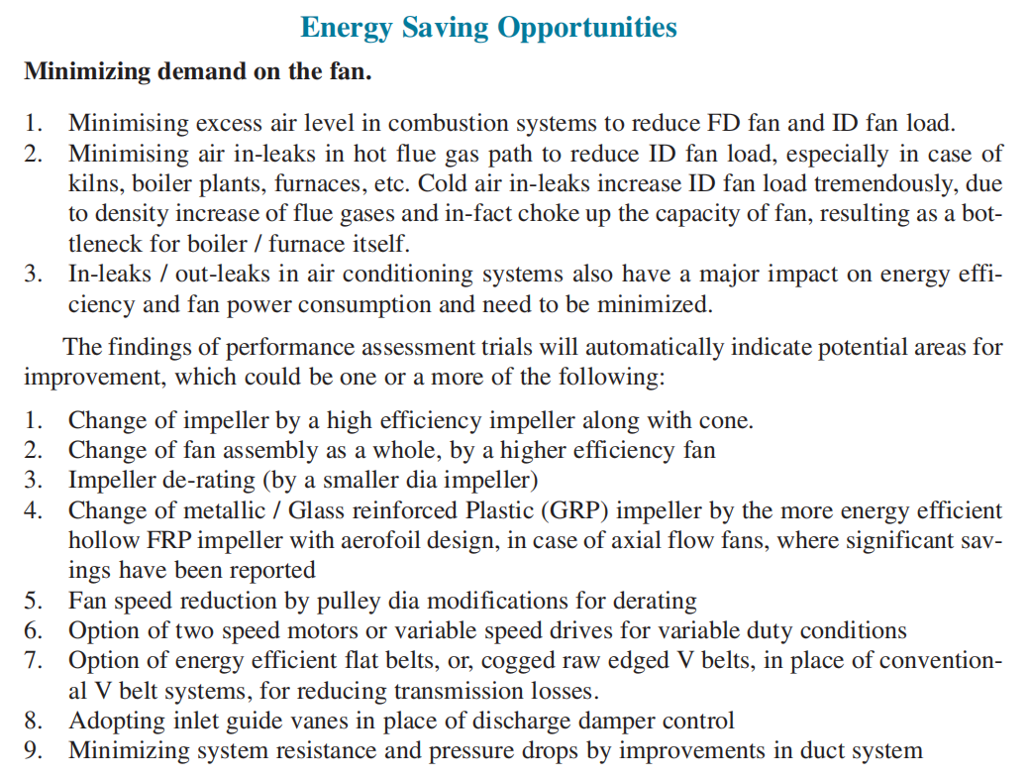
Continued...
Fans and Blower-
Industrial Process Fans are FD and ID.
The main difference between a Forced Draft (FD) Fan and Induced Draft (ID) Fan:-
FD fan forces outside air into the heating system.
ID fan draws flue gases from the system out into the atmosphere.
So we can say ID Fans are more safe for boilers.

